Slide 1
UI Fragments and the Fragment Manager

Slide 2
In this chapter, you will start building an application named CriminalIntent.
CriminalIntent records the details of “office crimes” – things like leaving dirty dishes in the breakroom sink or walking away from an empty shared printer after documents have printed.
With CriminalIntent, you can make a record of a crime including a title, a date, and a photo

Slide 3
It will have a list-detail interface: The main screen will display a list of recorded crimes. Users will be able to add new crimes or select an existing crime to view and edit its details

Slide 4
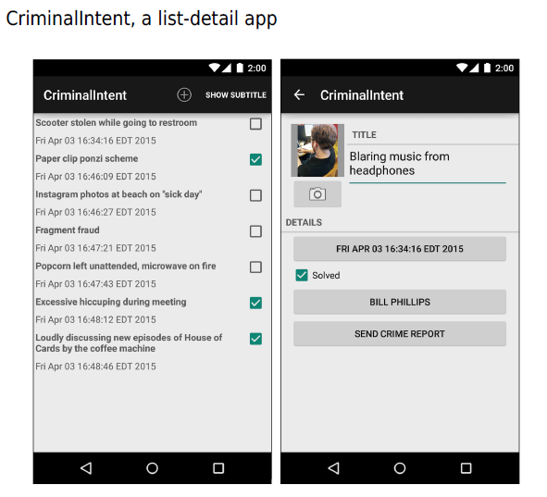

Slide 5
The Need for UI Flexibility
You might imagine that a list-detail application consists of two activities: one managing the list and the other managing the detail view. Clicking a crime in the list would start an instance of the detail activity.
Pressing the Back button would destroy the detail activity and return you to the list where you could select another crime.

Slide 6
Imagine that your user is running CriminalIntent on a tablet. Tablets and some larger phones have screens large enough to show the list and detail at the same time – at least in landscape orientation

Slide 7
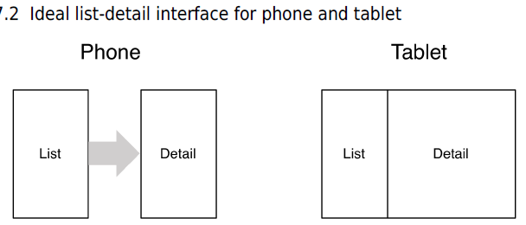

Slide 8
Imagine the user is viewing a crime on a phone and wants to see the next crime in the list. It would be better if the user could swipe to see the next crime without having to return to the list.
Each swipe should update the detail view with information for the next crime.

Slide 9
What these scenarios have in common is UI flexibility: the ability to compose and recompose an activity’s view at runtime depending on what the user or the device requires.
Activities were not built to provide this flexibility. An activity’s views may change at runtime, but the code to control those views must live inside the activity.
As a result, activities are tightly coupled to a particular screen used by the user.

Slide 10
Introducing Fragments
A fragment is a controller object that an activity can deputize to perform tasks. Most commonly, the task is managing a user interface.
The user interface can be an entire screen or just one part of the screen.

Slide 11
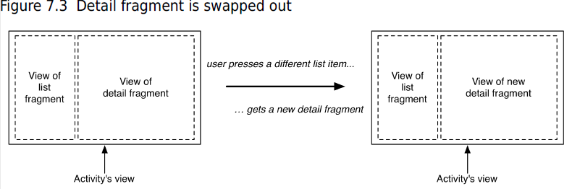

Slide 12
Using UI fragments separates the UI of your app into building blocks, which is useful for more than just list-detail applications.
Working with individual blocks, it is easy to build tab interfaces, tack on animated sidebars, and more.
Achieving this UI flexibility comes at a cost: more complexity, more moving parts, and more code.

Slide 13
Starting CriminalIntent
An instance of CrimeFragment will be hosted by an activity named CrimeActivity.
For now, think of hosting as the activity providing a spot in its view hierarchy where the fragment can place its view (Figure 7.5).
A fragment is incapable of getting a view on screen itself. Only when it is placed in an activity’s hierarchy will its view appear.

Slide 14
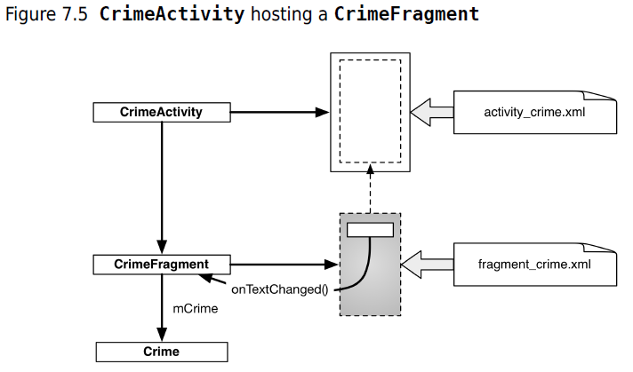

Slide 15
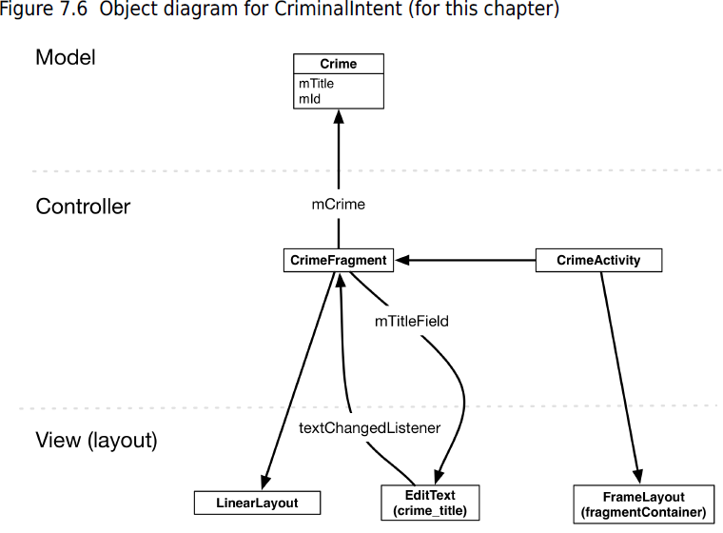

Slide 16
Three of the classes shown in Figure 7.6 are classes that you will write: Crime, CrimeFragment, and CrimeActivity.
An instance of Crime will represent a single office crime. In this chapter, a crime will have only a title and an ID.
The title is a descriptive name, like “Toxic sink dump” or “Someone stole my yogurt!”
The ID will uniquely identify an instance of Crime.

Slide 17
CrimeActivity’s view will consist of a FrameLayout that defines the spot where the CrimeFragment’s view will appear.
CrimeFragment’s view will consist of a LinearLayout and an EditText.
CrimeFragment will have a member variable for the EditText (mTitleField) and will set a listener on it to update the model layer when the text changes.

Slide 18
Create a new Android application. Name the application CriminalIntent.
name the activity CrimeActivity

Slide 19
Fragments and the support library
The support library includes a complete implementation of fragments that work all the way back to API level 4.
we will use the support implementation of fragments rather than the implementation built into the Android OS.
This is a good idea because the support library is quickly updated when new features are added to the fragments API.
To use those new features, you can update your project with the latest version of the support library.

Slide 20
There are two key classes that we will use from the support library: the Fragment class (android.support.v4.app.Fragment) and the FragmentActivity class (android.support.v4.app.FragmentActivity).
Using fragments requires activities that know how to manage fragments. The FragmentActivity class knows how to manage the support version of fragments.

Slide 21
Adding dependencies in Android Studio
To use the support library, your project must list it as a dependency. Open the build.gradle file located in your app module. Your project will come with two build.gradle files, one for the project as a whole and one for your app module.
We will edit the one located at app/build.gradle.
Navigate to the project structure for your project (File → Project Structure

Slide 22
Select the app module on the left and the Dependencies tab in the app module. The dependencies for the app module are listed here.
Use the + button and choose Library dependency to add a new dependency. Choose the support-v4 library from the list

Slide 23
In the package explorer, find and open CrimeActivity.java. Change CrimeActivity’s superclass to FragmentActivity.

Slide 24
Creating the Crime class
Adding to Crime class (Crime.java)
public class Crime {
private UUID mId;
private String mTitle;
public Crime() {
// Generate unique identifier
mId = UUID.randomUUID();
}
}

Slide 25
Generated getters and setter
generate only a getter for the read-only mId and both a getter and setter for mTitle.
public UUID getId() { return mId; } public String getTitle() { return mTitle; } public void setTitle(String Title) { this.mTitle = Title; }

Slide 26
Hosting a UI Fragment
To host a UI fragment, an activity must:
define a spot in its layout for the fragment’s view
manage the lifecycle of the fragment instance

Slide 27
The fragment lifecycle
The fragment lifecycle is similar to the activity lifecycle: it has stopped, paused, and running states, and it has methods you can override to get things done at critical points – many of which correspond to activity lifecycle methods.

Slide 28
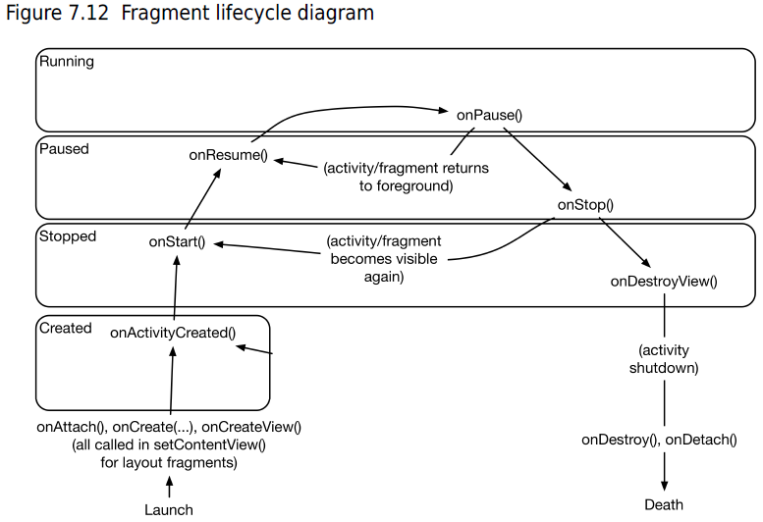

Slide 29
Two approaches to hosting
You have two options when it comes to hosting a UI fragment in an activity:
add the fragment to the activity’s layout
add the fragment in the activity’s code

Slide 30
The first approach is known as using a layout fragment. It is simple but inflexible.
If you add the fragment to the activity’s layout, you hardwire the fragment and its view to the activity’s view and cannot swap out that fragment during the activity’s lifetime.

Slide 31
The second approach, adding the fragment to the activity’s code, is more complex.
But it is the only way to have control at runtime over your fragments.
You determine when the fragment is added to the activity and what happens to it after that. You can remove the fragment, replace it with another, and then add the first fragment back again

Slide 32
Defining a container view
You will be adding a UI fragment in the hosting activity’s code, but you still need to make a spot for the fragment’s view in the activity’s view hierarchy. In CrimeActivity’s layout, this spot will be the FrameLayout

Slide 33
This FrameLayout will be the container view for a CrimeFragment. Notice that the container view is completely generic; it does not name the CrimeFragment class.
You can and will use this same layout to host other fragments.

Slide 34
Locate CrimeActivity’s layout at es/layout/activity_crime.xml. Open this file and replace the default layout with the FrameLayout.
Create fragment container layout (activity_crime.xml)
<FrameLayout xmlns:android="http://schemas.android.com/apk/res/android"
android:id="@+id/fragment_container"
android:layout_width="match_parent"
android:layout_height="match_parent"
/>

Slide 35
Creating a UI Fragment
The steps to creating a UI fragment are the same as those you followed to create an activity:
compose a user interface by defining widgets in a layout file
create the class and set its view to be the layout that you defined
wire up the widgets inflated from the layout in code

Slide 36
Defining CrimeFragment’s layout
CrimeFragment’s view will display the information contained within an instance of Crime.
Figure 7.15 shows the layout for CrimeFragment’s view. It consists of a vertical LinearLayout that contains an EditText.
EditText is a widget that presents an area where the user can add or edit text.

Slide 37
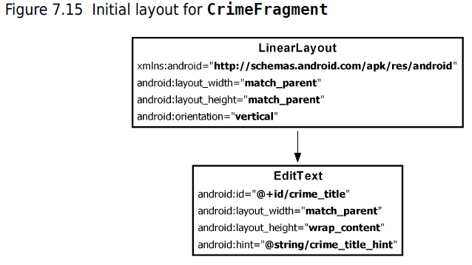

Slide 38
create a layout file and Name this file fragment_crime.xml and enter LinearLayout as the root element.
Layout file for fragment’s view (fragment_crime.xml)
<LinearLayout xmlns:android="http://schemas.android.com/apk/res/android"
android:layout_width="match_parent"
android:layout_height="match_parent"
android:orientation="vertical"
>
<EditText android:id="@+id/crime_title"
android:layout_width="match_parent"
android:layout_height="wrap_content"
android:hint="@string/crime_title_hint"
/>
</LinearLayout>

Slide 39
Adding a string (res/values/strings.xml)
<?xml version="1.0" encoding="utf-8"?>
<resources>
<string name="app_name">CriminalIntent</string>
<string name="hello_world">Hello world!</string>
<string name="action_settings">Settings</string>
<string name="crime_title_hint">Enter a title for the crime.</string>
</resources>

Slide 40
Creating the CrimeFragment class
Create and Name the class CrimeFragment.
Now, turn this class into a fragment. Update CrimeFragment to subclass the Fragment class.

Slide 41
Implementing fragment lifecycle methods
CrimeFragment is a controller that interacts with model and view objects. Its job is to present the details of a specific crime and update those details as the user changes them.

Slide 42
In CrimeFragment.java, add a member variable for the Crime instance and an implementation of
Fragment.onCreate(Bundle).
Listing 7.11 Overriding Fragment.onCreate(Bundle)
(CrimeFragment.java)
public class CrimeFragment extends Fragment {
private Crime mCrime;
@Override
public void onCreate(Bundle savedInstanceState) {
super.onCreate(savedInstanceState);
mCrime = new Crime();
}

Slide 43
There are a couple of things to notice in this implementation. First, Fragment.onCreate(Bundle) is a public method whereas Activity.onCreate(Bundle) is protected.
Fragment.onCreate(…) and other Fragment lifecycle methods must be public because they will be called by whatever activity is hosting the fragment.

Slide 44
Second, similar to an activity, a fragment has a bundle to which it saves and retrieves its state.
You can override Fragment.onSaveInstanceState(Bundle) for your own purposes just like with
Activity.onSaveInstanceState(Bundle).

Slide 45
Also, note what does not happen in Fragment.onCreate(…): you do not inflate the fragment’s view.
You configure the fragment instance in Fragment.onCreate(…), but you create and configure the fragment’s view in another fragment lifecycle method:
public View onCreateView(LayoutInflater inflater, ViewGroup container, Bundle savedInstanceState)

Slide 46
This method is where you inflate the layout for the fragment’s view and return the inflated View to the hosting activity.
The LayoutInflater and ViewGroup parameters are necessary to inflate the layout.
The Bundle will contain data that this method can use to recreate the view from a saved state.

Slide 47
Overriding onCreateView(…) (CrimeFragment.java)
@Override
public View onCreateView(LayoutInflater inflater, ViewGroup container,
Bundle savedInstanceState) {
View v = inflater.inflate(R.layout.fragment_crime, container, false);
return v;
}

Slide 48
Within onCreateView(…), you explicitly inflate the fragment’s view by calling LayoutInflater.inflate(…) and passing in the layout resource ID.
The second parameter is your view’s parent, which is usually needed to configure the widgets properly.
The third parameter tells the layout inflater whether to add the inflated view to the view’s parent.
You pass in false because you will add the view in the activity’s code.

Slide 49
Wiring widgets in a fragment
The onCreateView(…) method is also the place to wire up the EditText to respond to user input.
After the view is inflated, get a reference to the EditText and add a listener.

Slide 50
Wiring up the EditText widget (CrimeFragment.java)
private Crime mCrime;
private EditText mTitleField;
…
View v = inflater.inflate(R.layout.fragment_crime, container, false);
mTitleField = (EditText)v.findViewById(R.id.crime_title);
mTitleField.addTextChangedListener(new TextWatcher() {
@Override
public void beforeTextChanged(
CharSequence s, int start, int count, int after) {
// This space intentionally left blank
}
@Override
public void onTextChanged(
CharSequence s, int start, int before, int count) {
mCrime.setTitle(s.toString());
}
@Override
public void afterTextChanged(Editable s) {
// This one too
}
});

Slide 51
Getting references in Fragment.onCreateView(…) works nearly the same as in Activity.onCreate(…). The only difference is that you call View.findViewById(int) on the fragment’s view.

Slide 52
Setting listeners in a fragment works exactly the same as in an activity. you create an
anonymous class that implements the TextWatcher listener interface. TextWatcher has three methods, but you only care about one: onTextChanged(…).
In onTextChanged(…), you call toString() on the CharSequence that is the user’s input.
This method returns a string, which you then use to set the Crime’s title.

Slide 53
Adding a UI Fragment to the FragmentManager
When the Fragment class was introduced in Honeycomb, the Activity class was changed to include a piece called the FragmentManager.
The FragmentManager is responsible for managing your fragments and adding their views to the activity’s view hierarchy

Slide 54
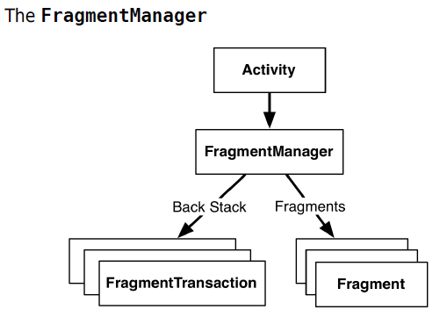

Slide 55
To add a fragment to an activity in code, you make explicit calls to the activity’s FragmentManager.
The first step is to get the FragmentManager itself. In CrimeActivity.java, add the following code to onCreate(…).

Slide 56
Getting the FragmentManager (CrimeActivity.java)
protected void onCreate(Bundle savedInstanceState) {
super.onCreate(savedInstanceState);
setContentView(R.layout.activity_crime);
FragmentManager fm = getSupportFragmentManager();
}

Slide 57
You call getSupportFragmentManager() because you are using the support library and the FragmentActivity class.
If you were not interested in using the support library, then you would subclass Activity and call getFragmentManager().

Slide 58
Fragment transactions
Adding a CrimeFragment (CrimeActivity.java)
FragmentManager fm = getSupportFragmentManager();
Fragment fragment = fm.findFragmentById(R.id.fragment_container);
if (fragment == null) {
fragment = new CrimeFragment();
fm.beginTransaction()
.add(R.id.fragment_container, fragment)
.commit();

Slide 59
Fragment transactions are used to add, remove, attach, detach, or replace fragments in the fragment list.
They are the heart of how you use fragments to compose and recompose screens at runtime.
The FragmentManager maintains a back stack of fragment transactions that you can navigate.

Slide 60
The FragmentManager.beginTransaction() method creates and returns an instance of FragmentTransaction.
The FragmentTransaction class uses a fluent interface - methods that configure FragmentTransaction return a FragmentTransaction instead of void, which allows you to chain them together

Slide 61
The add(…) method is the meat of the transaction. It has two parameters: a container view ID and the newly created CrimeFragment.
The container view ID should look familiar. It is the resource ID of the FrameLayout that you defined in activity_crime.xml.

Slide 62
A container view ID serves two purposes:
• It tells the FragmentManager where in the activity’s view the fragment’s view should appear.
• It is used as a unique identifier for a fragment in the FragmentManager’s list.

Slide 63
When you need to retrieve the CrimeFragment from the FragmentManager, you ask for it by container view ID:
Fragment fragment = fm.findFragmentById(R.id.fragment_container);

Slide 64
It may seem odd that the FragmentManager identifies the CrimeFragment using the resource ID of a FrameLayout.
But identifying a UI fragment by the resource ID of its container view is built into how the FragmentManager operates.
If you are adding multiple fragments to an activity, you would typically create separate containers with separate IDs for each of those fragments.

